Slide 1
2017 Operating Report
By: Eric Lu

Slide 2
Bikes

Slide 3
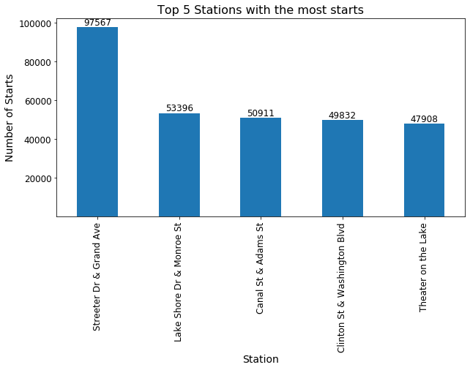
Top 5 stations with the most starts
Station | Annual # of Trip
Streeter Dr & Grand Ave | 97,567
Lake Shore Dr & Monroe St | 53,396
Canal St & Adams St | 50,911
Clinton St & Washington Blvd | 49,832
Theater on the Lake | 47,908

Slide 4
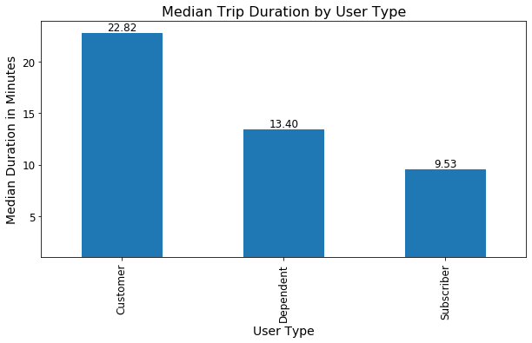
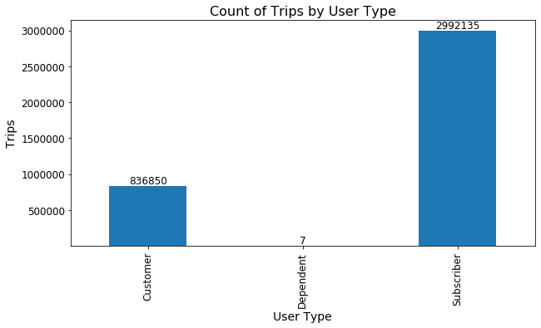
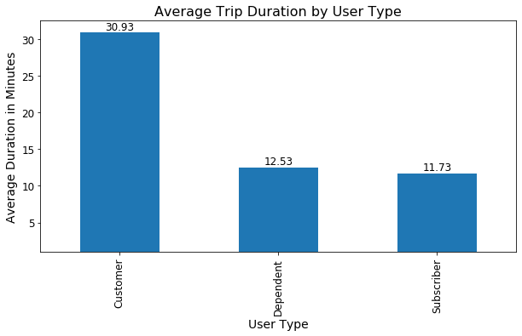
Trip duration by user type

Slide 5
Most popular trips based on start station and stop station
From Station |  | To Station |  | Count
Lake Shore Dr & Monroe St |  | Streeter Dr & Grand Ave |  | 12,171
Streeter Dr & Grand Ave |  | Streeter Dr & Grand Ave |  | 10,042
Streeter Dr & Grand Ave |  | Theater on the Lake |  | 8,180
Streeter Dr & Grand Ave |  | Lake Shore Dr & North Blvd |  | 7,993
Lake Shore Dr & North Blvd |  | Streeter Dr & Grand Ave |  | 7,226

Slide 6
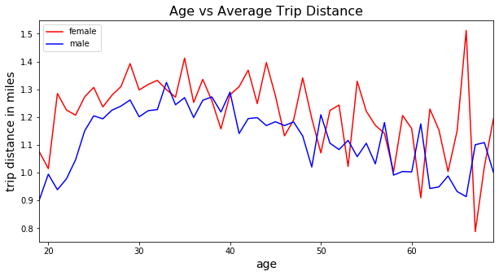
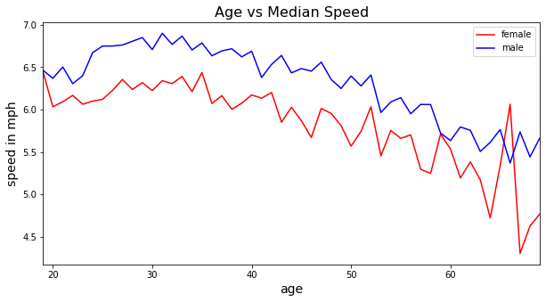
Rider Performance
gender | age_group | median_speed | avg_distance
Female | (17, 25] | 6.115334 | 1.254441
 | (25, 35] | 6.296069 | 1.310329
 | (35, 45] | 6.067444 | 1.279189
 | (45, 55] | 5.766373 | 1.192859
 | (55, 65] | 5.385137 | 1.110877
 | (65, 70] | 4.930709 | 1.14618
Male | (17, 25] | 6.598445 | 1.118305
 | (25, 35] | 6.790378 | 1.23898
 | (35, 45] | 6.596099 | 1.21895
 | (45, 55] | 6.30398 | 1.121446
 | (55, 65] | 5.82915 | 1.042199
 | (65, 70] | 5.49597 | 1.019229

Slide 7
Busiest bikes in Chicago in 2017
Bike ID | Total Time Ridden (hrs) | # of Trips
2565 | 375.4 | 1,489
5880 | 344.9 | 1,177
5293 | 331.1 | 1,049
5479 | 326.2 | 1,044
5731 | 322.6 | 1,027
Bike ID | # of Trips | Total Time Ridden (hrs)
2565 | 1,489 | 375.4
3308 | 1,234 | 294.4
3489 | 1,225 | 293.6
3128 | 1,210 | 304.1
5880 | 1,177 | 344.9

Slide 8
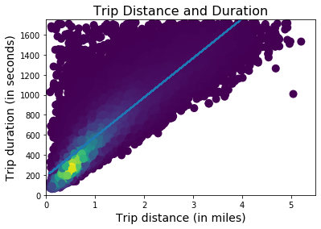
Model
Trips usually start at 3 minutes + 6 additional minutes per additional mile traveled
R^2 Accuracy of 0.717
Use subscribers as a baseline, their data is more uniform and makes for a more accurate model

Slide 9


Slide 10
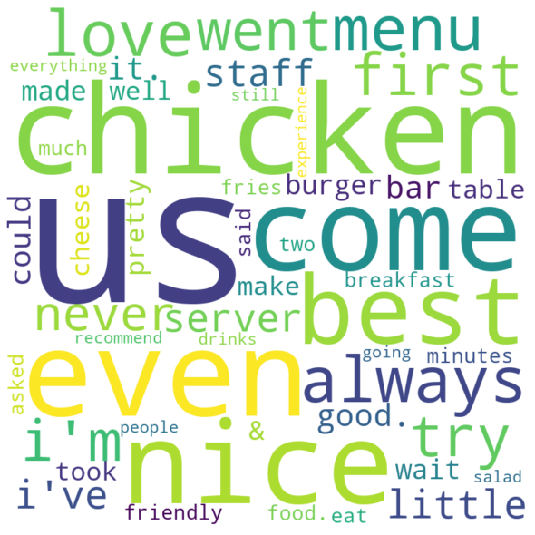
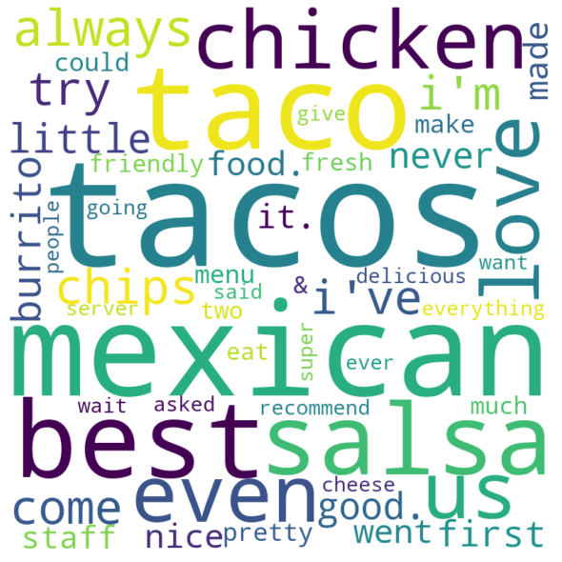
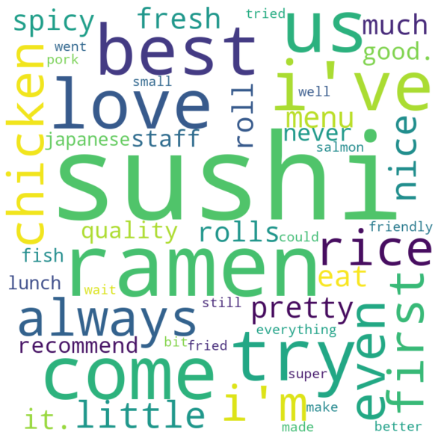
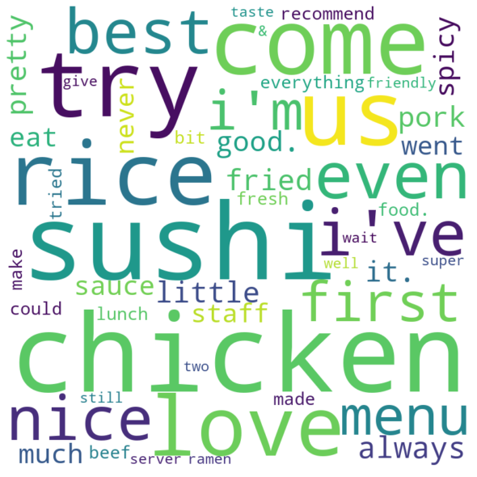
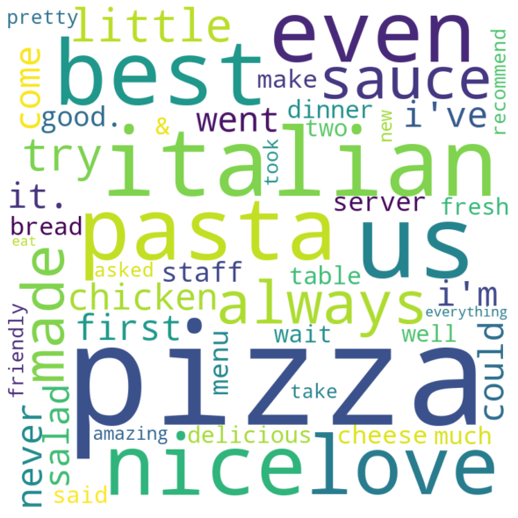
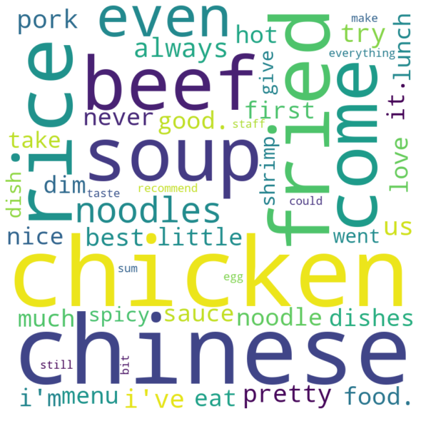
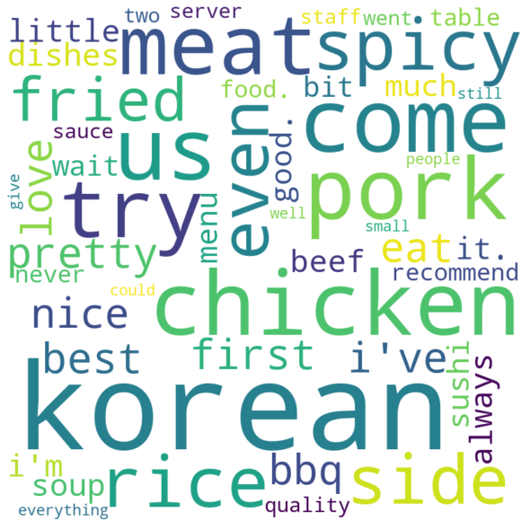
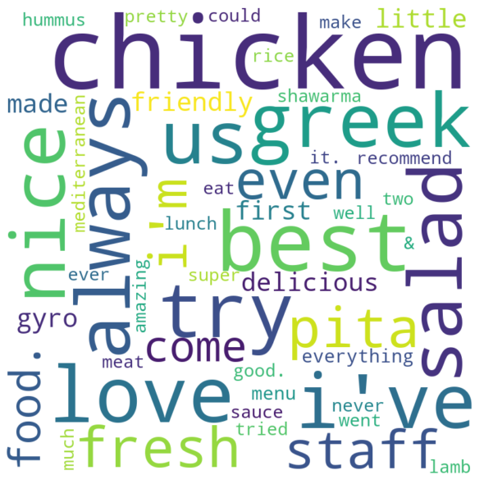
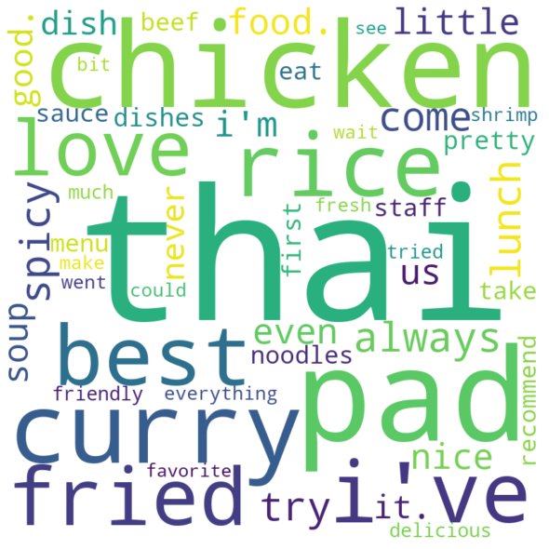
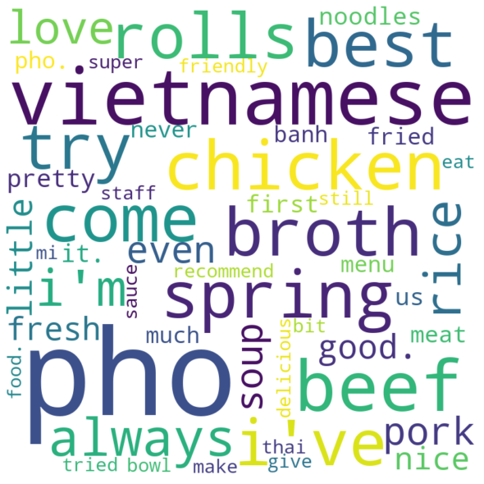
Top Cuisines
American | Mexican | Japanese | Asian Fusion | Italian
Chinese | Korean | Mediterranean | Thai | Vietnamese
Check-ins: 437,747 | Check-ins: 148,515 | Check-ins: 134,682 | Check-ins: 107,330 | Check-ins: 102,731
Check-ins: 88,369 | Check-ins: 49,618 | Check-ins: 44,528 | Check-ins: 42,237 | Check-ins: 36,642
Common Keywords: got, definitely, service, came, food, go, really, one, ordered, place, time, restaurant, like, get, also, would, order, back, good, great

Slide 11
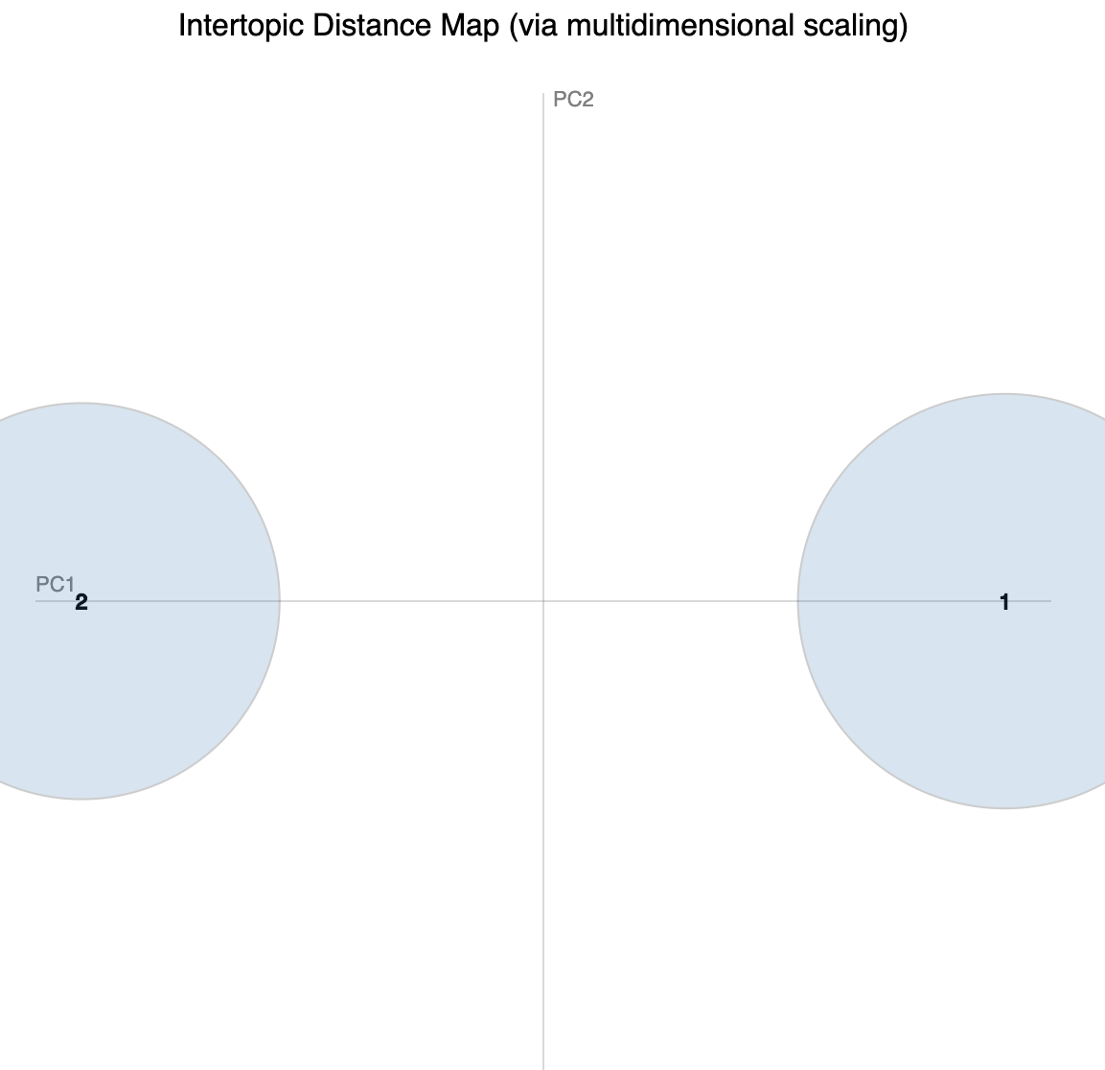
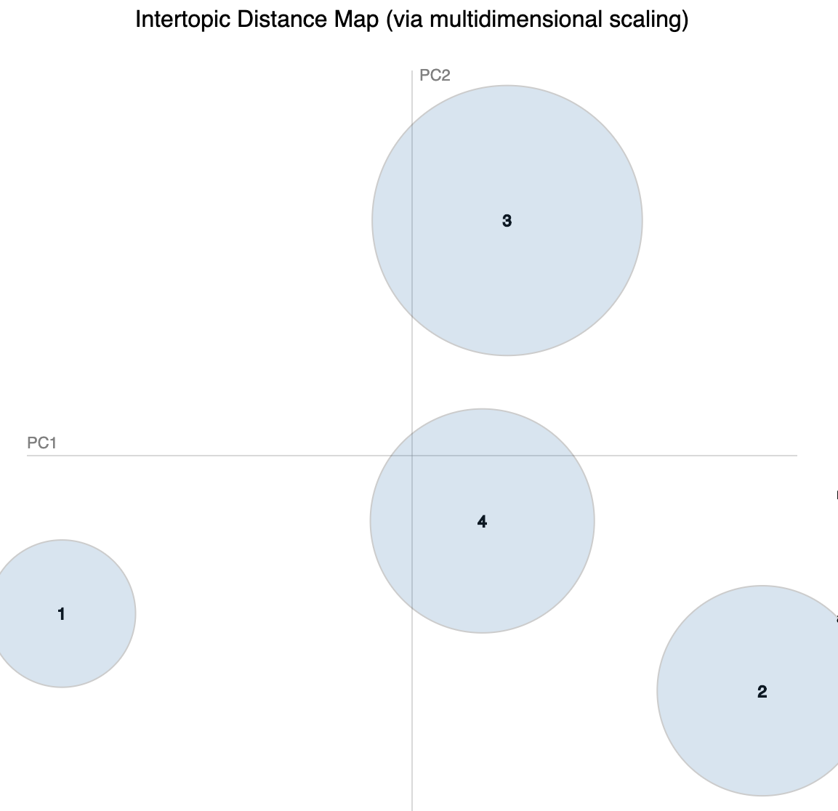
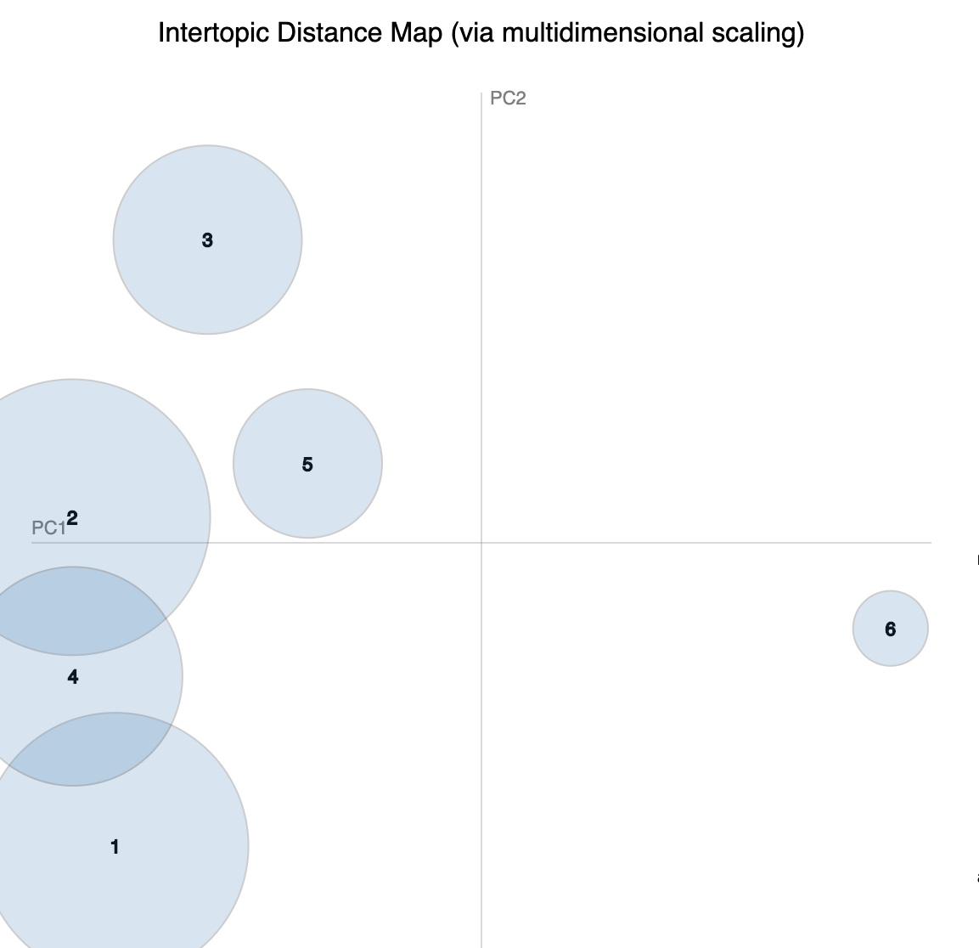
Topics
Not enough topics, topics begin to generalize
Optimal Number of topics: 4
Topics grow too similar past 4

Slide 12
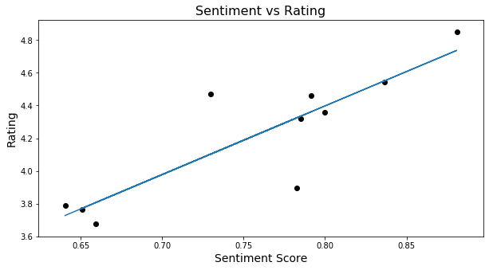
Sentiment vs Rating
The Correlation between sentiment and rating is strong with a correlation of 0.86
r^2 : 0.749
correlation : 0.865

